Slide 1





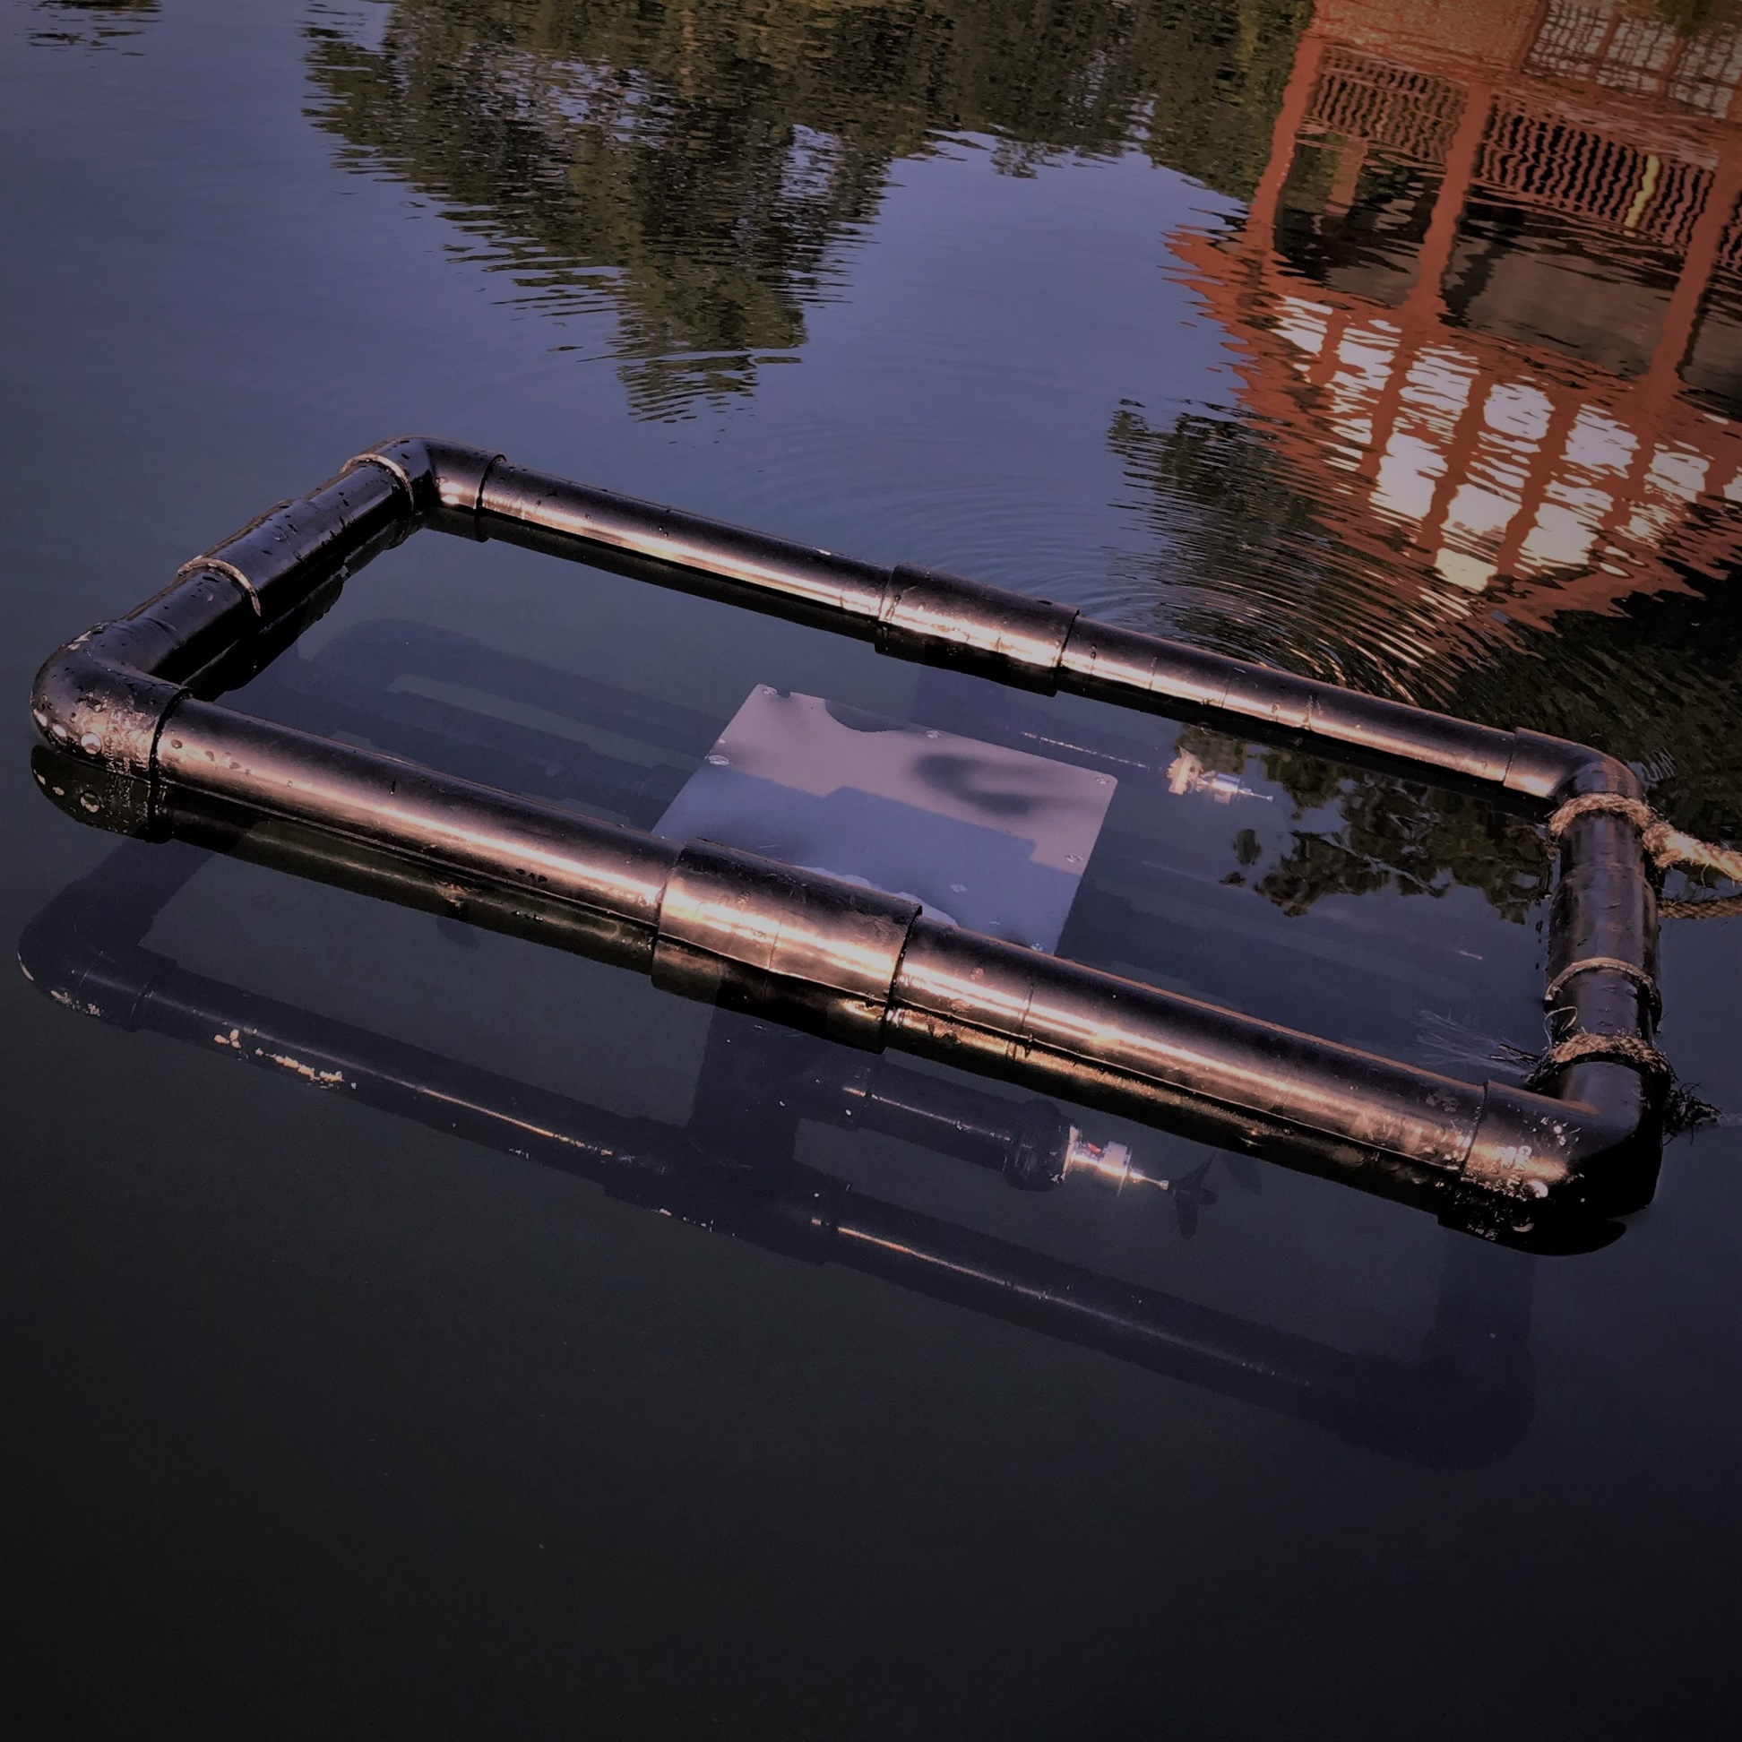
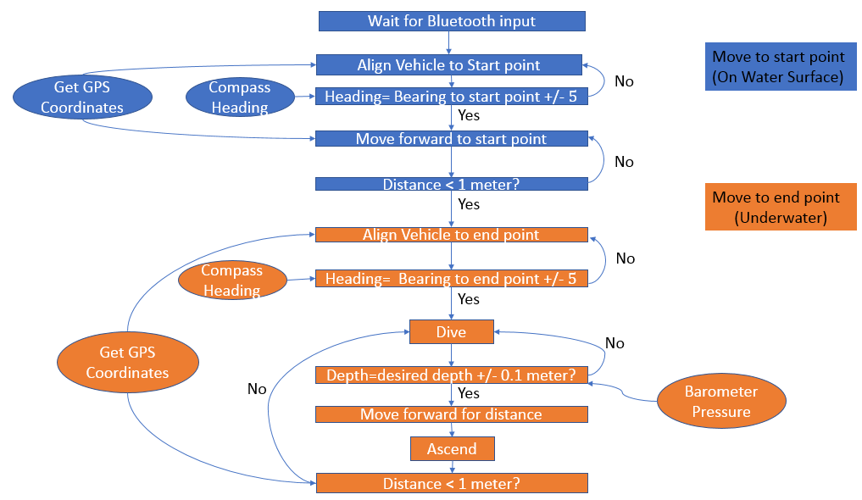
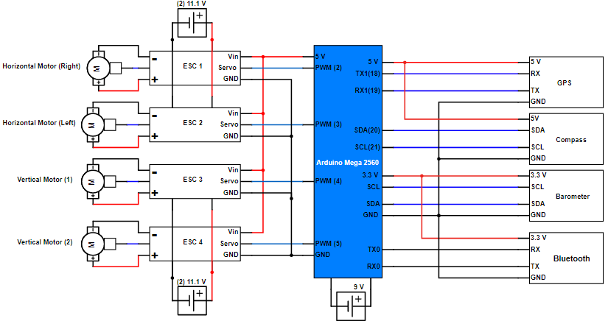
So Close Yet Sonar
Wentworth Institute of Technology BSEE
Rayyan Alabad
Abdullah Aldkhel
Patrick Jochim
Prof. Joseph Santacroce
Abstract
Design Concept
Components
Design and build the autonomous underwater vehicle (AUV).
Develop algorithm using C language on Arduino controller to control AUV motors to move to desired location.
Utilize compass and depth sensors with the GPS as inputs to the system for the AUV’s positioning.
Microcontroller:
  Arduino Mega 2560.
Localization:
  Ultimate GPS Module.
Depth Measurement Sensor:
  MS5803-14BA Barometer.
Magnetometer:
  HMC388L
Hardware :
  (4) 11.1 V batteries, 9 V battery, (4) Brushless Motors, (4) ESCs, (4) propellers, 1-1/2” PVC pipes.
Bluetooth transceiver:
  Bluetooth: SH-HC-08
SD card Data Logger :
  Virtuabotix SD Card Reader/Writer
Flow Chart
Schematics
Conclusions
  Sensors were tested using LED lights as actuators to achieve expected results
  The AUV is designed to be less dense than water but only to a degree which the motors can control its depth.
  Motors operate by user input.
  Bluetooth connection was established to send desired inputs to microcontroller.

